Slide 1
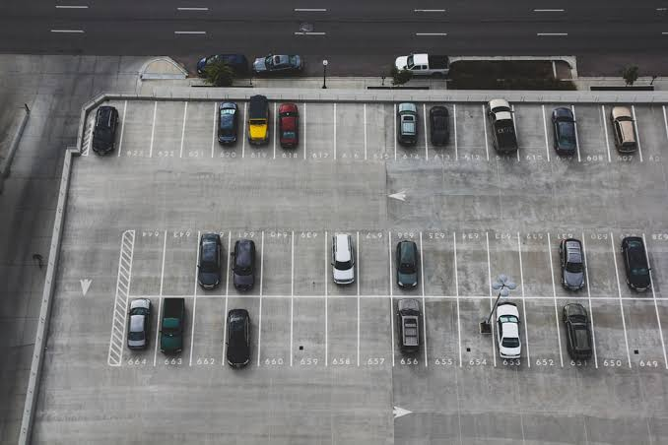
Parking slot detection
Team Members
Ajit.C
Ajith prasanna.A
Gokulpandy.D
Ashwin.R
Mentor:Nagendran.K

Slide 2
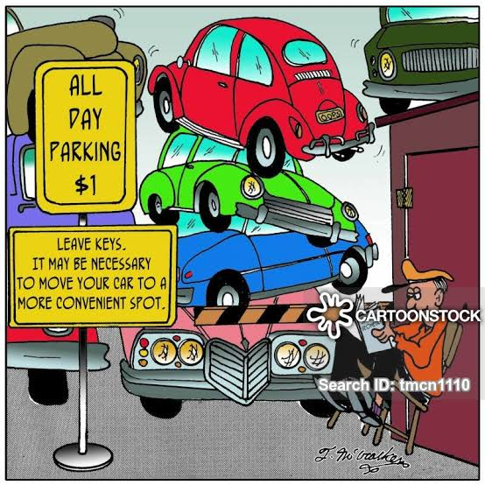

INTRODUCTION
The growth of the number of vehicles in a city leads to the issue of limited number of parking lots available, with the help of computer vision it has become easier and faster for creating a special monitoring system which searches for free parking spaces in order to reduce the amount of time required for searching the vacant place.
The idea of the project is that the camera detects the available places using the computer vision and image processing and shows to the user the vacant parking lots, indicating them as a green area and the vehicle itself is marked with a red frame.
As a result, the user is able to see the availability of parking place in real time.

Slide 3
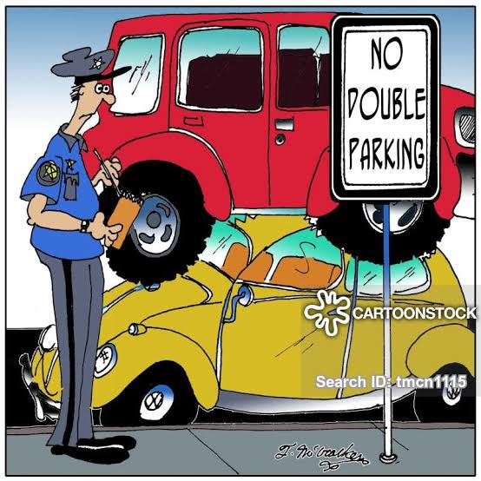
INTRODUCTION
The image recognition technology develops rapidly in recent years. Cameras have become cheaper, smaller, and of higher quality than ever before.
With this advance and computational technologies, the computer vision has gradually become an essential part of the everyday life.

Slide 4
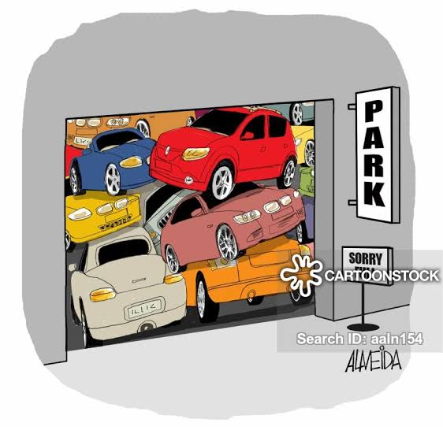
ABSTRACT
The main scope of the presented Project was the development of an innovative product for the management of city parking lots.
Our application will ensure the implementation of the Smart City concept by using computer vision and communication platforms, which enable the development of new integrated digital services.
The use of video cameras could simplify and lower the costs of parking lot controls. In the aim of parking space detection, an aggregated decision was proposed, employing various metrics, computed over a sliding window interval provided by the camera.

Slide 5
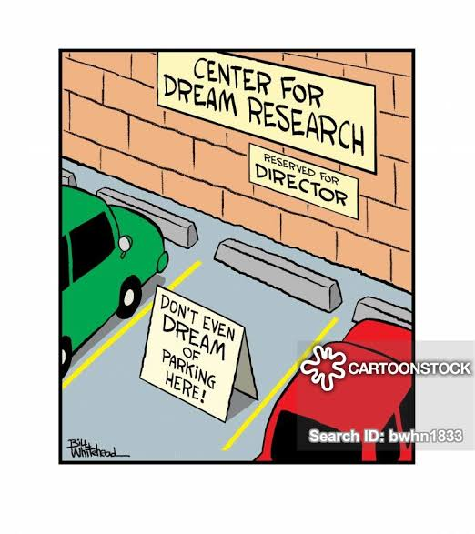
ABSTRACT
The history created over 20 images provides an adaptive method for background and accurate detection. The system has shown high robustness in two benchmarks, achieving a recognition rate higher than 93%.
Looking through a reasonable parking spot in a populated metropolitan city is amazingly hard for drivers. Genuine gridlock may happen because of the inaccessible parking spot.
Programmed shrewd stopping framework is arising field and pulled in PC vision scientists to contribute in this field of innovation

Slide 6
Literature survey
The discrepancy between incoming and outgoing cars can be used to calculate the total number of cars in the parking lot.
In the modern society, there is an ever-increasing number of vehicles. This is leading to problems such as large urban parking lots becoming inefficient, increasing difficulty to find open spaces in busy parking lots, as well as the increasing need to devote larger areas of land for additional parking spaces.
The entire parking area available for parking can be examined through a camera using vision-based methods, the data is then analyzed, and the result obtained will specify the exact number and location of available parking spaces.

Slide 7
Proposed work
System will get a Livestream video of the parking lot from the camera.
Images are captured when a car enters or leaves the parking lot.
RGB Images are converted to grayscale images.
Do calibration First select the coordinates of the parking lot. This will crop the extra space other than the parking lot from the image. Secondly, select the coordinates of the single parking slot. This will divide the parking lot into equal size slots.

Slide 8
ADVANTages
Provides Accurate information.
Accurate in displaying Available parking slots.
Easy to access.
User friendly.

Slide 9
DATASET
The total number of 4,374 samples in a dataset is divided into a training set and a testing set. The ratio between the training and the testing set might vary depending on the difficulty of the task. In the case of vehicle detection, the dataset was divided approximately equally between two sets.
The training dataset represents the set of training samples, or vectors of value. It is a collection of positive and negative data. Usually they are grouped by the same number of components or features

Slide 10
ALGORITHM
The Image Processing Chain
During this stage, the main goal of the proposed algorithm resides in assigning a status to each parking space based on the extraction of several different image features from the map provided in the initial configuration.
Frame Preprocessing
Preprocessing is performed on the images acquired from the video camera, in order to remove noise as well as to smooth the edges. We apply Smooth Median (size) and Smooth Blur (ksize) to the original image of the type RGB.

Slide 11
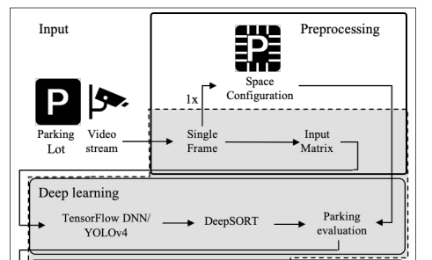
architecture

Slide 12
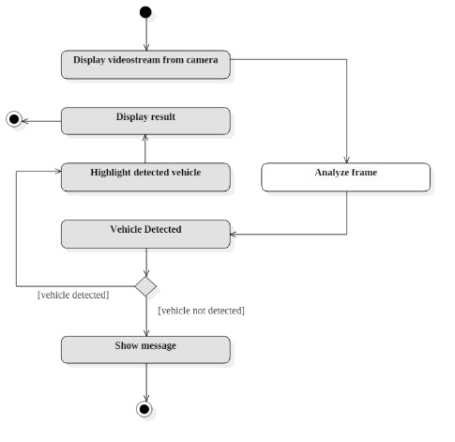
DATA FLOW DIAGRAM

Slide 13
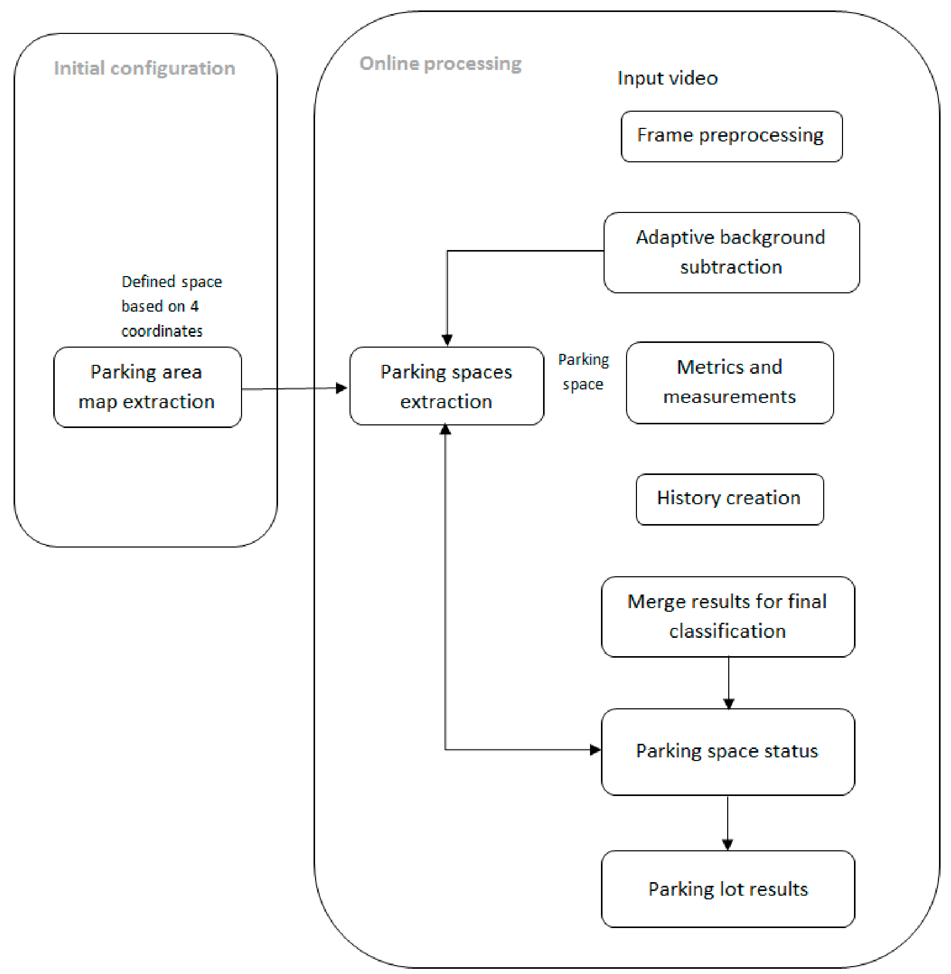
PROCESS DIAGRAM

Slide 14
LIBRARIES USED
OpenCV is a cross-platform library using which we can develop real-time computer vision applications. It mainly focuses on image processing, video capture and analysis including features like face detection and object detection.
YAML (a recursive acronym for "YAML Ain't Markup Language") is a human-readable data-serialization language. It is commonly used for configuration files and in applications where data is being stored or transmitted.
NumPy is a Python library used for working with arrays. It also has functions for working in domain of linear algebra, fourier transform, and matrices.

Slide 15
TASK 1-PARKING AREA DETECTION
Detect parking area features in images (e.g., lines, corners, patterns...)
Generate a map of parking keys
Evaluate your results
The first step in the pipeline is to detect all possible parking spaces in a frame of video. Obviously we need to know which parts of the image are parking spaces before we can detect which parking spaces are unoccupied.

Slide 16
TASK 2-2D,3D REGISTRATION
Compute a transformation of the 2D image and the 3D point cloud
Given a set of correspondences
Detect and visualize all free parking spaces
Label points in occupied parking spaces as cars
The second step is to detect all the cars in each frame of video. This will let us track the movement of each car from frame to frame.

Slide 17
TASK 3-CAR DETECTION
Registration from previous task provides a segmentation of cars
Use these point clouds as training examples to compute car features
Implement a car detector
The third step is to determine which of the parking spaces are currently occupied by cars and which aren’t. This requires combining the results of the first and second steps

Slide 18
PROCESS INVOLVED
confidence score of the object detection. The higher the number, the more certain the model is that it correctly identified the object.
The bounding box of the object in the image, given as X/Y pixel locations.
A “bitmap mask” that tells which pixels within the bounding box are part of the object and which aren’t. With the mask data, we can also work out the outline of the object.

Slide 19
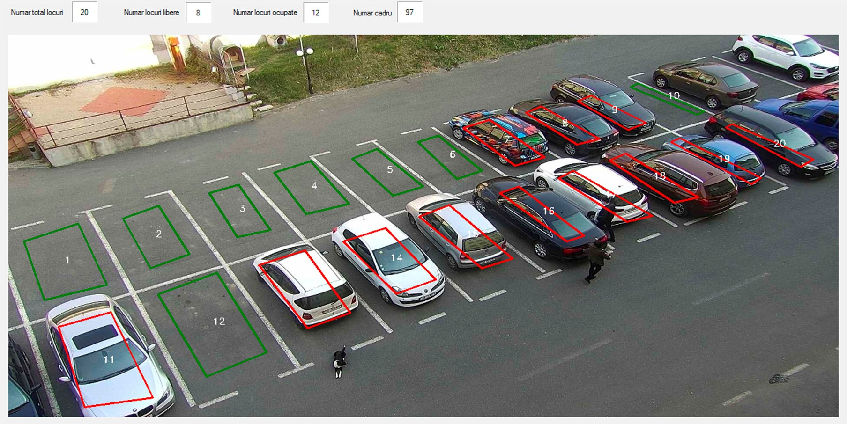
screenshots

Slide 20
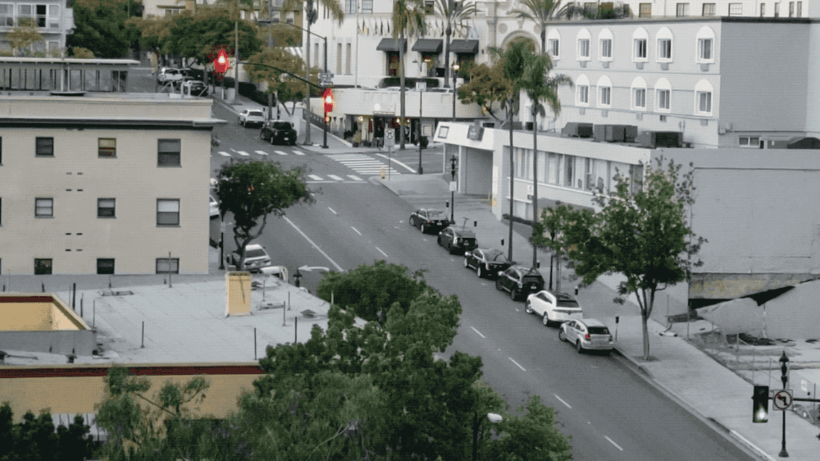

Slide 21
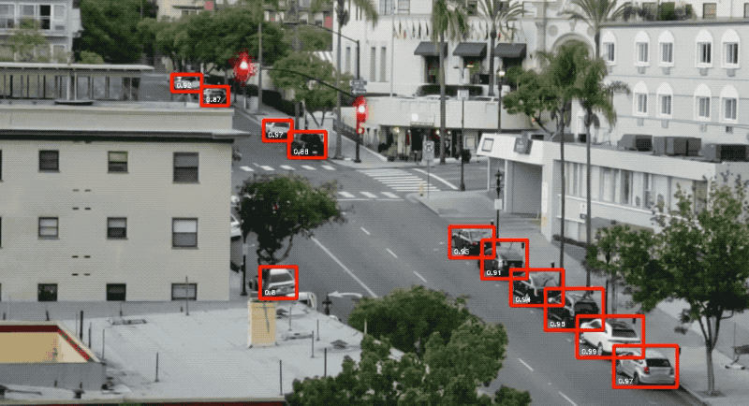

Slide 22
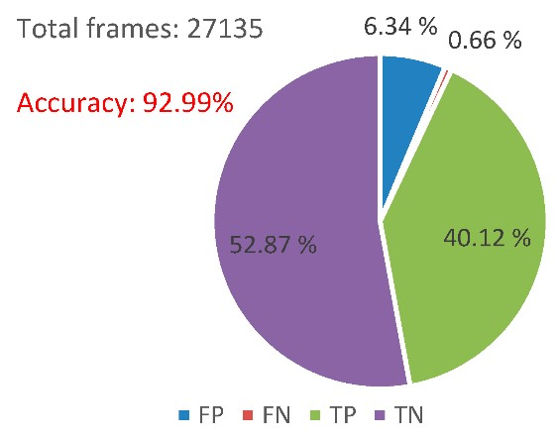
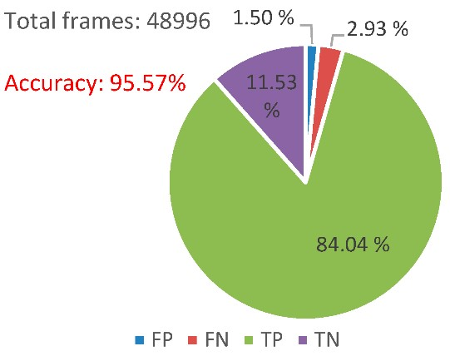

Slide 23
conclusion
The fundamental commitment of this investigation is to advance the recognizable proof of accessible stopping openings to conceivably decrease the blockage in the stopping field. Because of headway in AI and vision base innovation practical programmed stopping frameworks encourage the drivers to find accessible spaces at stopping fields. Future specialists can zero in on portion explicit area to clients as of now enlisted from internet stopping the executive's framework. In this paper, a video detection system for parking lot occupancy has been described.

Slide 24
references
Ming-Yee Chiu; Depommier, R.; Spindler, T.; , "An embedded real- time vision system for 24-hour indoor/outdoor car-counting applications," Pattern Recognition, 2004.
Zhang Bin; Jiang Dalin; Wang Fang; Wan Tingting; , "A design of parking space detector based on video image," Electronic Measurement & Instruments, 2009.
T. Mar; N. Marcel;, “ Video-based parking space detection,” 2012 [Online]. Available: http://www.ini.rub.de/data/documents/ tschentscherneuhausen_parking_space_fbi2012.pdf
Ichihashi, H.; Notsu, A.; Honda, K.; Katada, T.; Fujiyoshi, M.; , "Vacant parking space detector for outdoor parking lot by using surveillance camera and FCM classifier," Fuzzy Systems, 2009. FUZZ-IEEE 2009.
Boda, V.K.; Nasipuri, A.; Howitt, I.; , "Design considerations for a wireless sensor network for locating parking spaces," SoutheastCon, 2007.
Fabian, T. , "An Algorithm for Parking Lot Occupation Detection," Computer Information Systems and Industrial Management Applications, 2008.

Slide 25
Thank you

